Slide 1

TA#1 - Welcome to Cognitive Robotics (097244)!
Yotam Granov / 30.10.22

Slide 2
What is a “cognitive robot”?

Slide 3
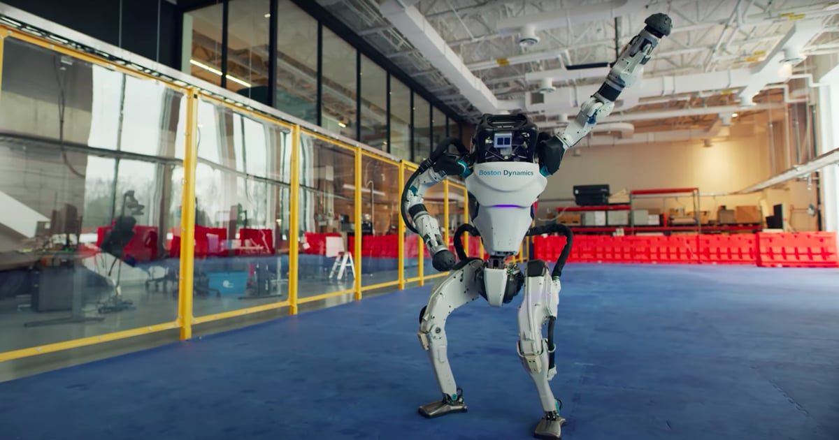


Are these cognitive robots?

Slide 4
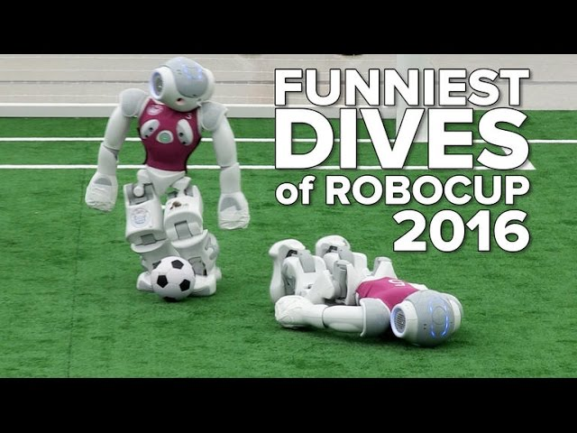
What about these?

Slide 5
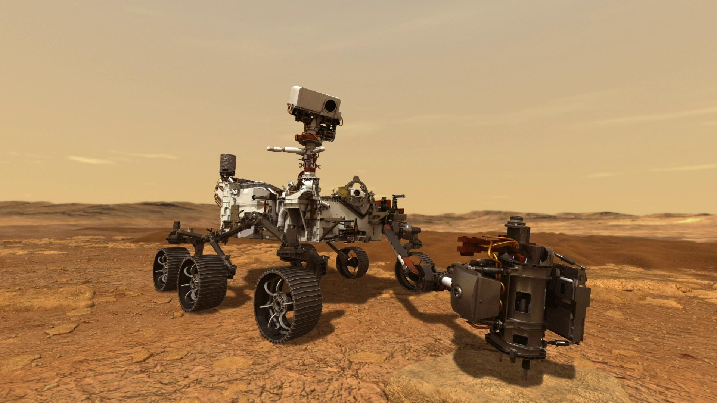
Okay so what makes a robot “cognitive”?
Wikipedia: “ Cognitive Robotics is a subfield of robotics concerned with endowing a robot with intelligent behavior by providing it with a processing architecture that will allow it to learn and reason about how to behave in response to complex goals in a complex world “
A cognitive robot should:
Monitor itself for potential problems (both observable and hidden)
Schedule tasks in time
Devise novel plans to achieve desired goals over time
Collaborate with other (autonomous) agents
Deal with risk ...
Typically controlled by a model-based AI programs (models of the robot, the world, possible actions, other agents)
AI program reasons about the model to make decisions
** Content borrowed from Dr. Sarah Keren’s “AI & Robotics” course

Slide 6
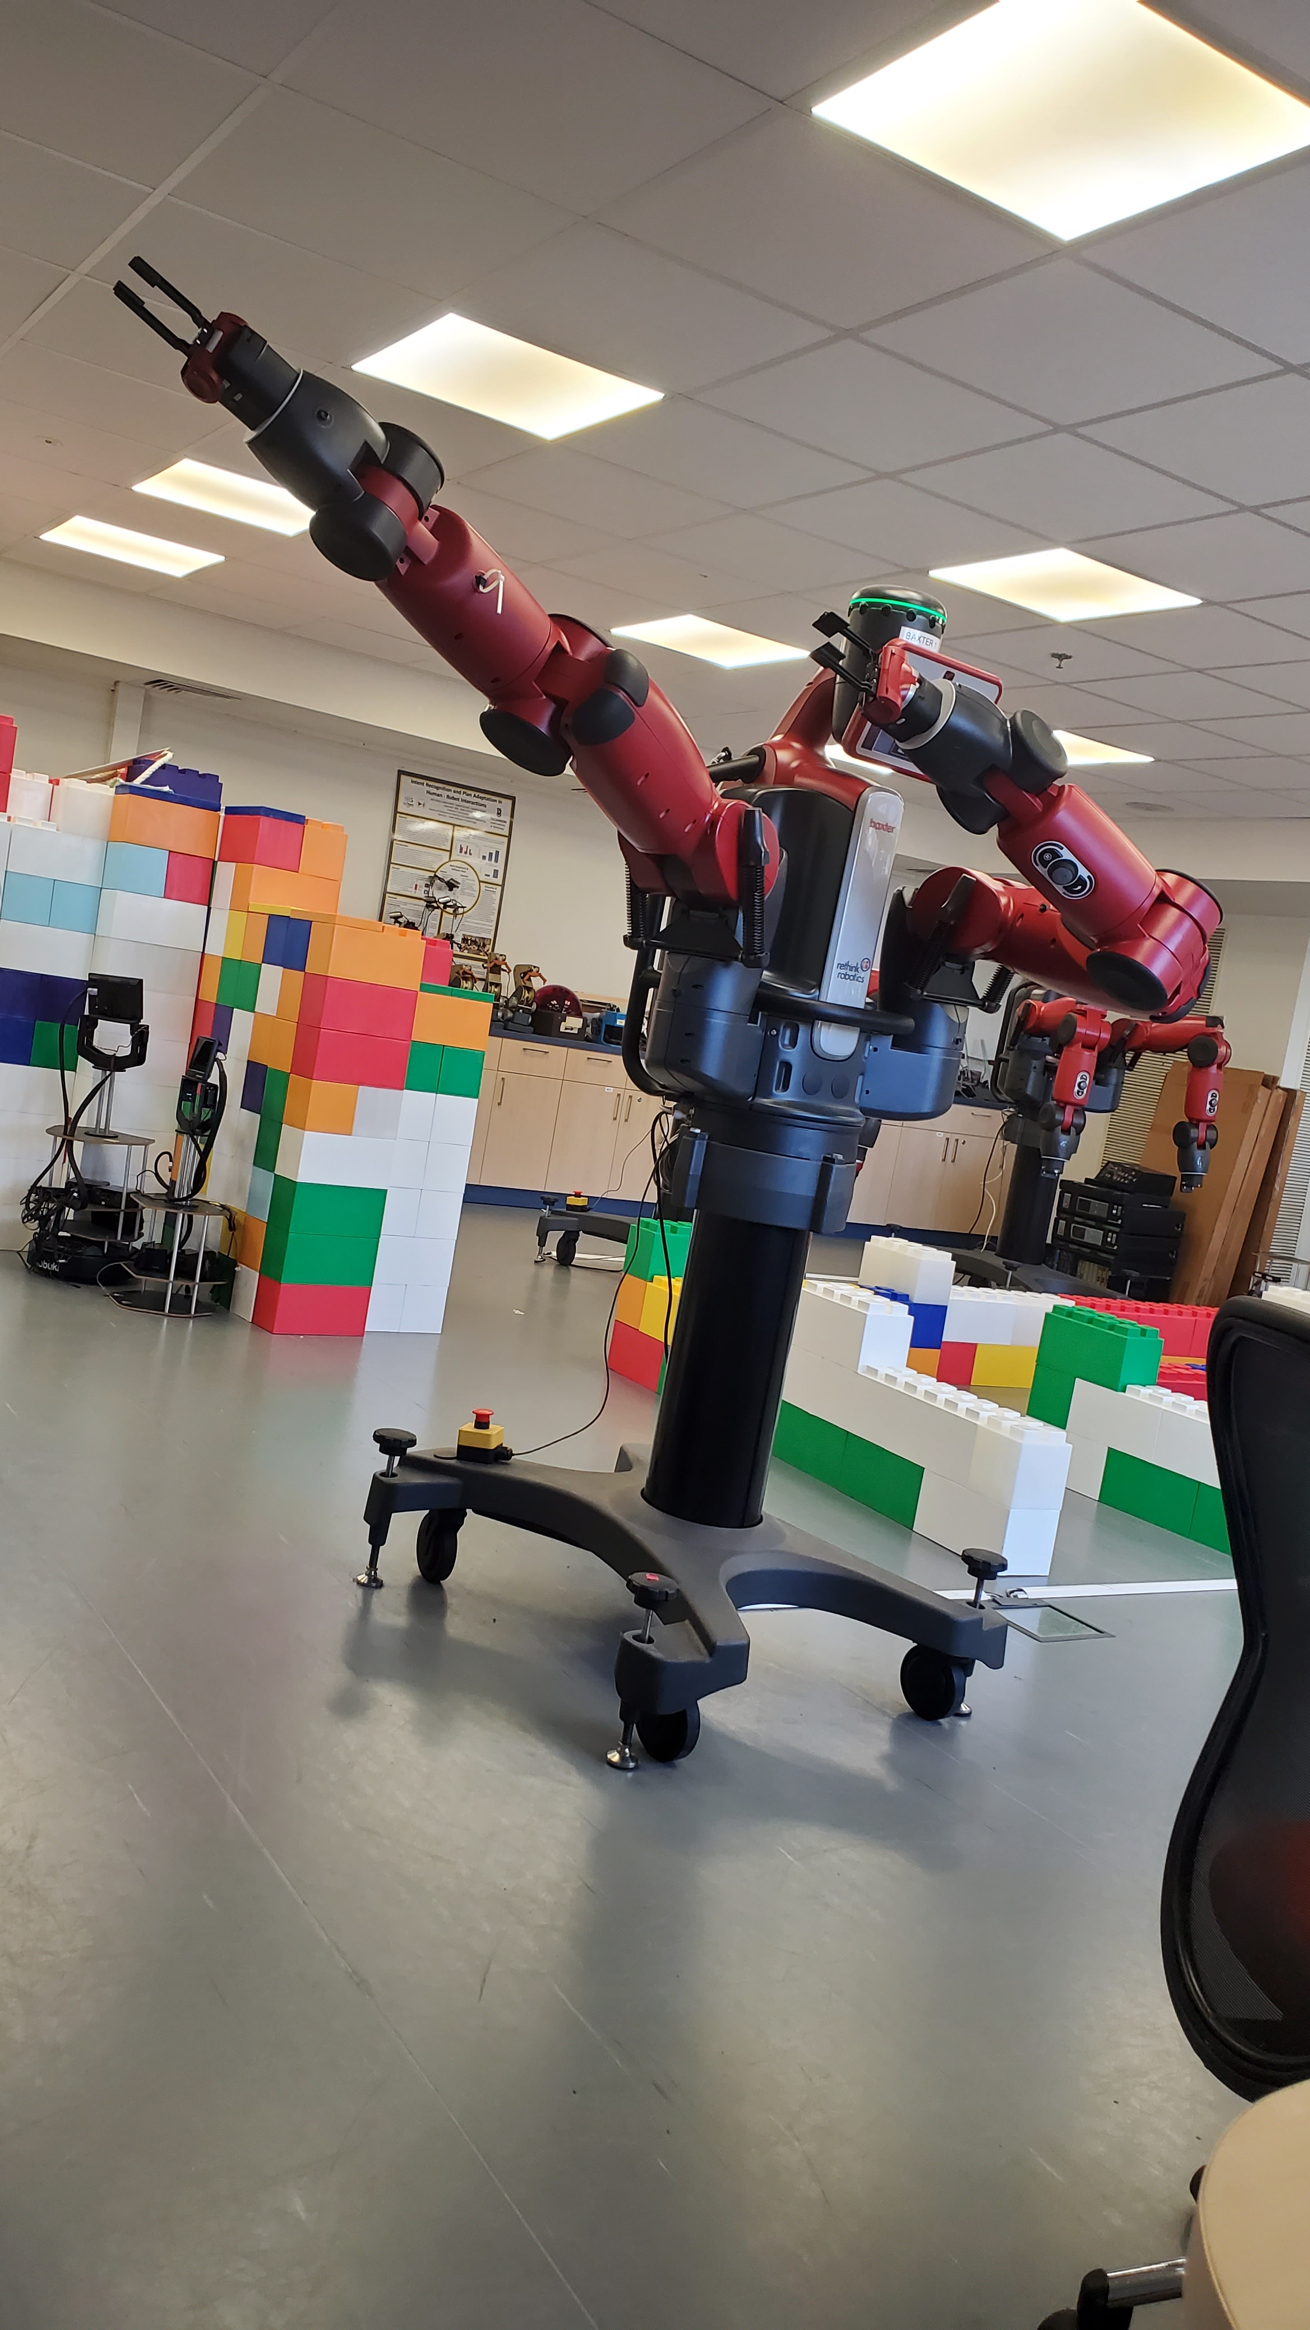

What will we learn this semester?
1
Classical (Task) Planning
2
Temporal Planning & Scheduling
3
Probabilistic Planning
4
Motion Planning
5
Task & Motion Planning
6
Reinforcement Learning (?)
** Today: OOP, Next Week: PDDL

Slide 7
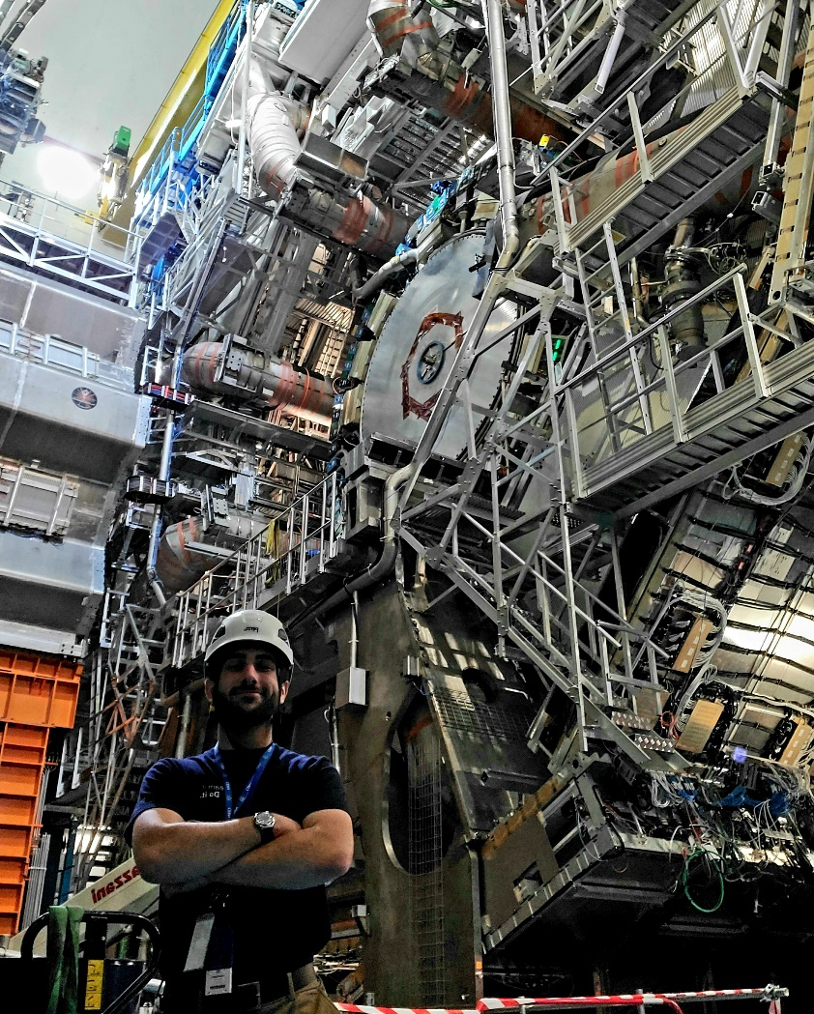
Who am I? (some ethos)
4th-year MechE & Physics undergrad student from NY
Experimental physicist at CERN
Avionics engineer for JERICCO, a lunar nanosatellite
Researching plasma-enhanced aerodynamics for Martian flight vehicles
TA for “Experimental Methods in Particle Physics” (Spring)
Co-Founder of Technion Robotics Initiative
Not an expert on the material of this course (that would be Erez)
** Point of this slide (I swear it’s not an ego boost): We will have a fun time with this course + Working in a variety of scientific fields is fun, if you want advice or help getting involved in any of the fields I mentioned above please let me know!!!

Slide 8

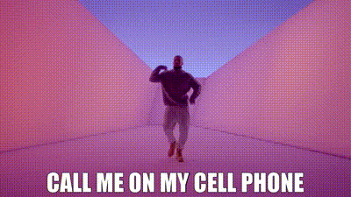
Why am I here?
- “By teaching, we learn”, Seneca the Younger (maybe)
How to contact me?
Cell: +972-58-552-5548
Email: yotam.g@campus.technion.ac.il
Office: Cognitive Robotics Lab (just shoot me a text to set a meeting)

Slide 9
Who are you?

